Slide 1




Slide 2



Slide 3



Web Server
Web Application Server
DB

Slide 4
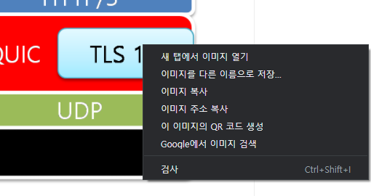

Slide 5




Client
Web Server
CSS, HTML. 이미지…
Web Application Server
동적 컨텐츠
DB
DB

